Slide 1
Sequencer board MKII : GS / Freedom electronics design
Has the SWO trace signal been brought out to the debug header?
See you tube phil’s lab

Slide 2
Sequencer MkII
Firmware: SeqMk2PcbTest

Slide 3
Serial port command record

Slide 4
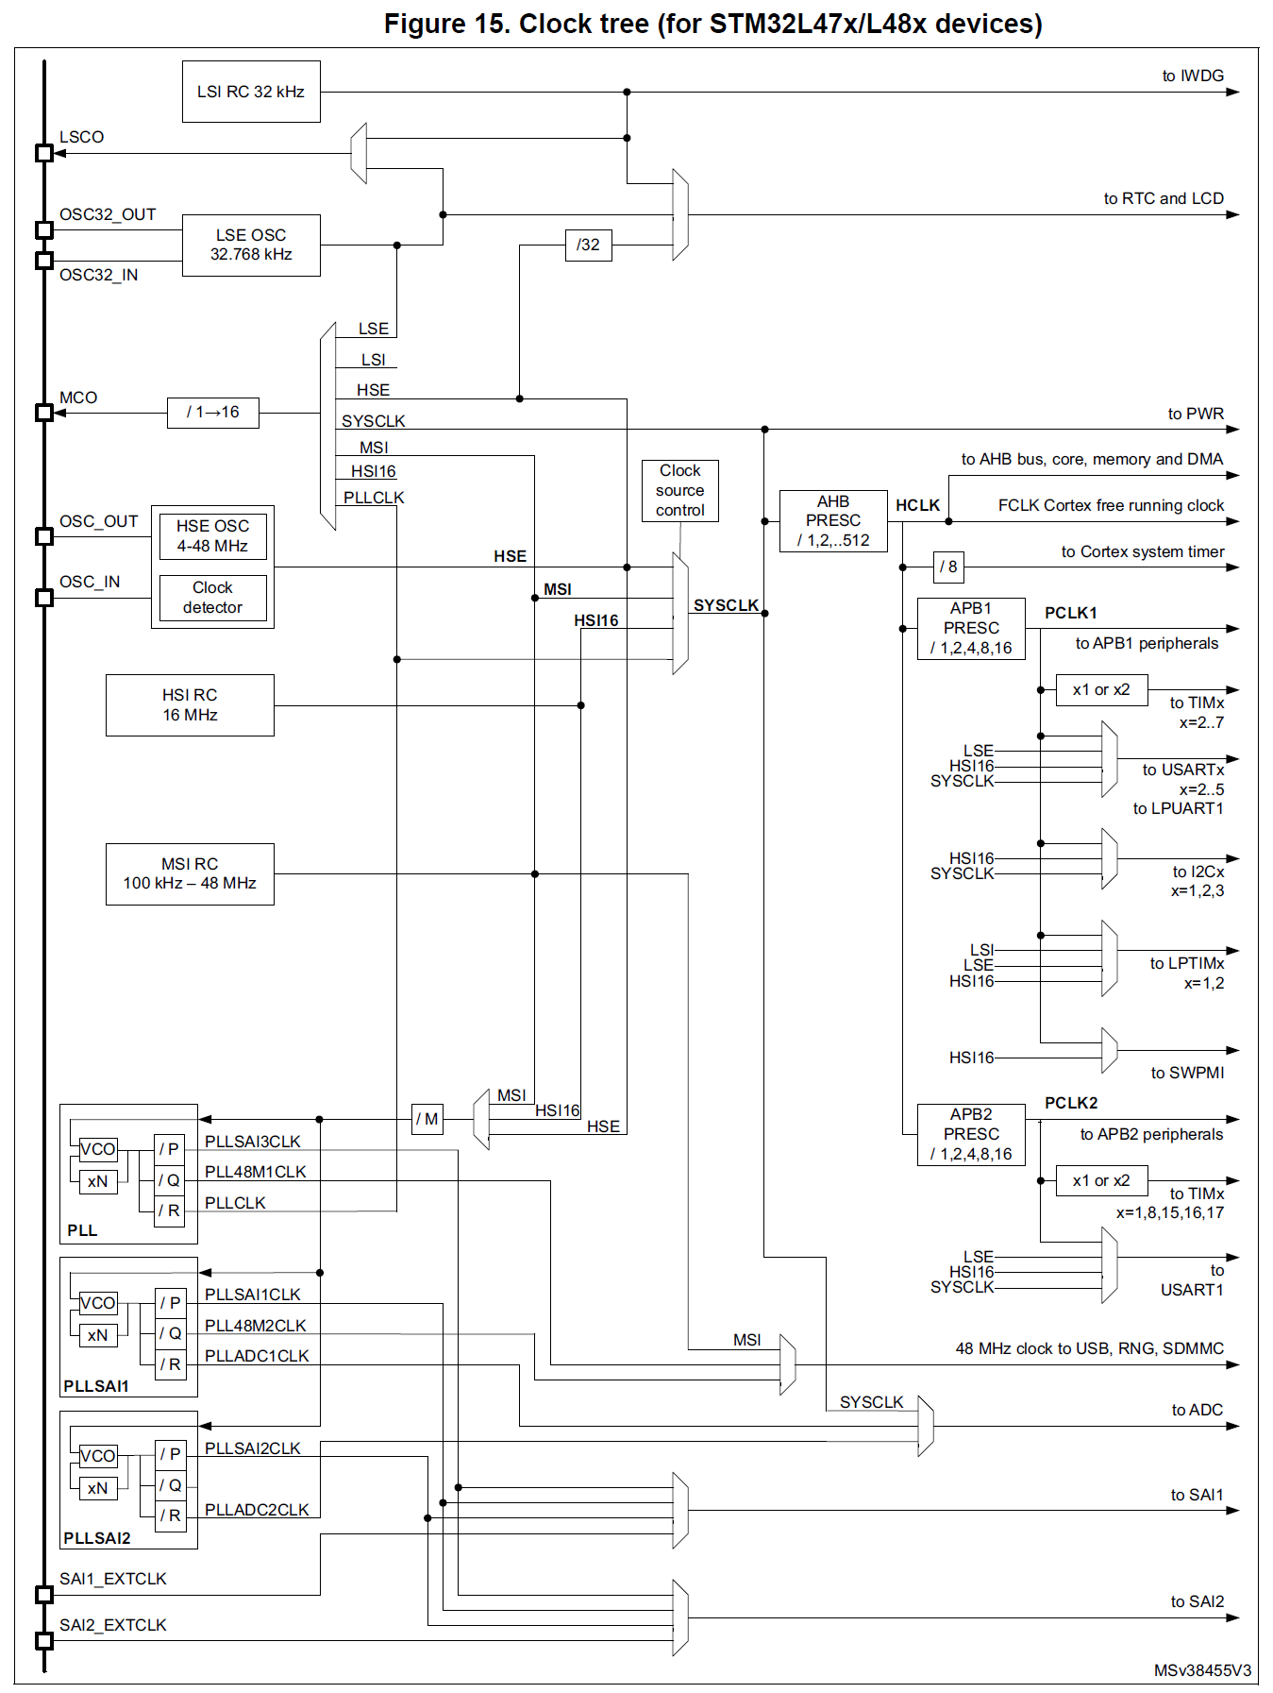
RCC (Reset & Clock Control) configuration
8MHz – too high hence not installed
/16
2.5MHz
RCC_MCO: Master clock output
PA8
/1
40MHz
40MHz
HSE Missing
40MHz
40MHz
/1
40MHz
High speed internal RC based clock
40MHz
/2,x10, /2
Multispeed internal RC based clock

Slide 5
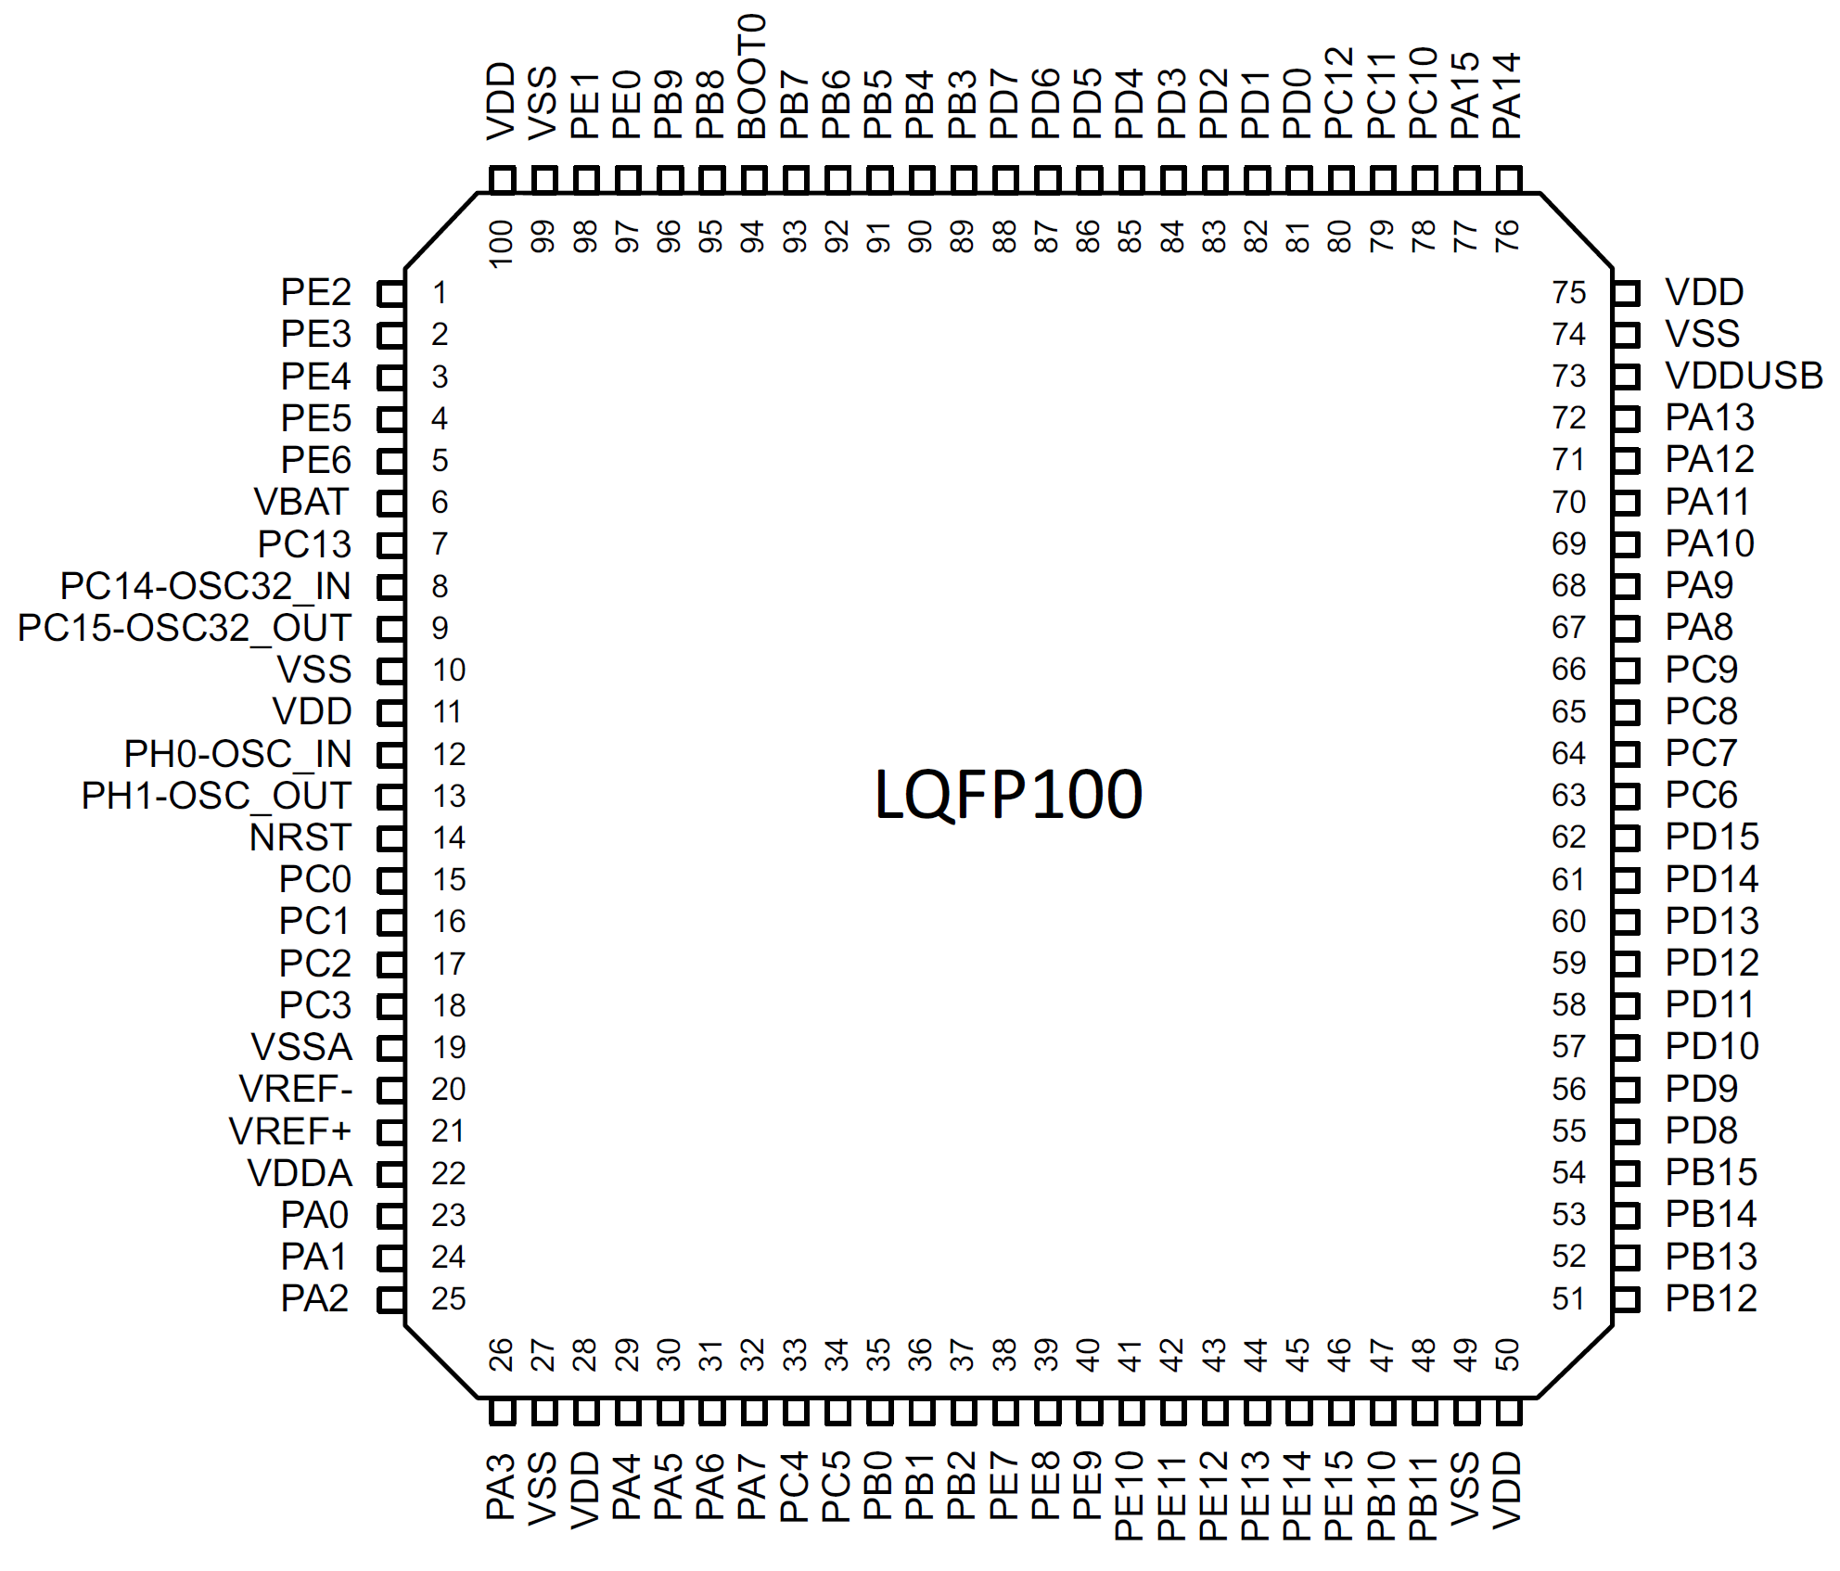
STM32L476VCT6
RCC_MCO
400ns period = 2.5MHz

Slide 6
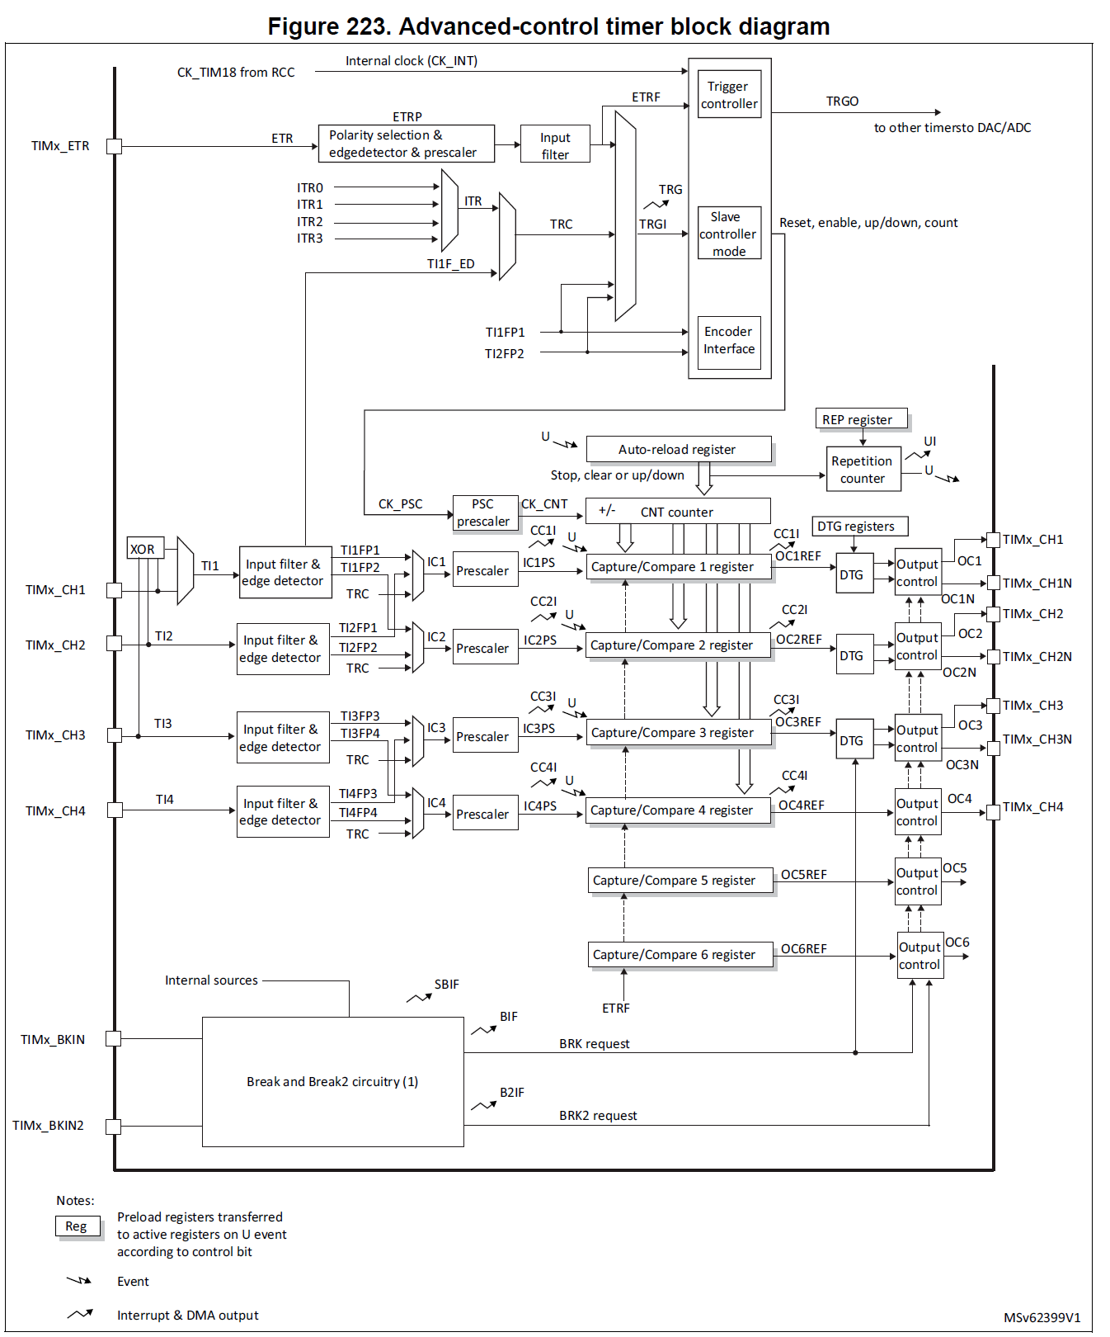
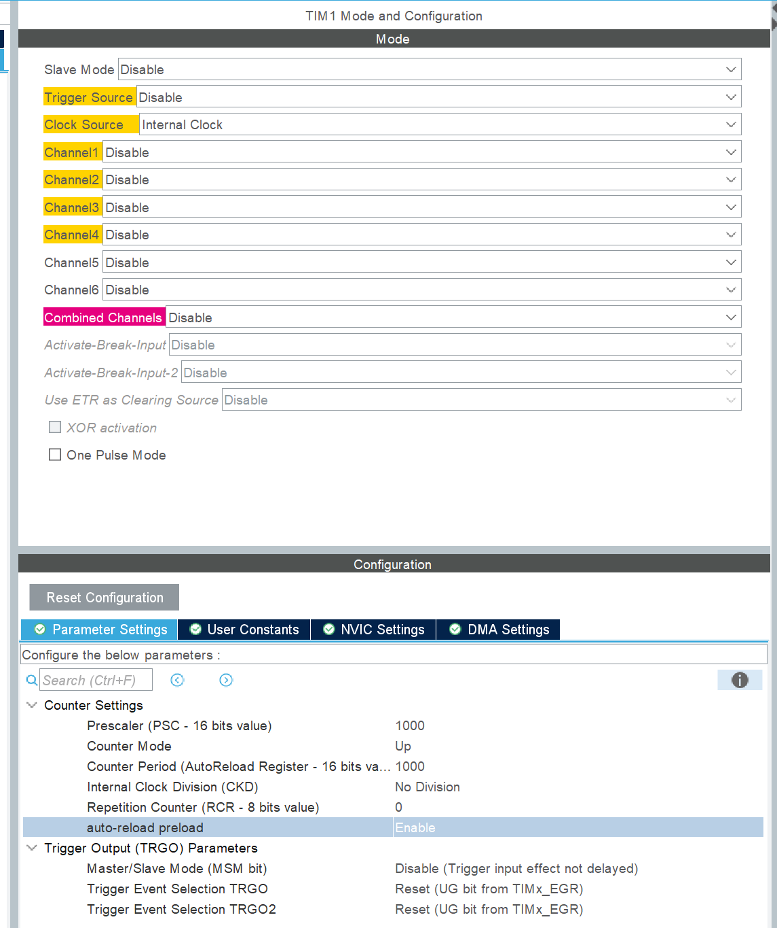
TIM1 configuration
40MHz
999
1000
40kHz
40Hz

Slide 7
999
Reload
Update event
1kHz
/39
Prescsaler
CK-CNT
1MHz
Timer 1
40MHz
RST

Slide 8
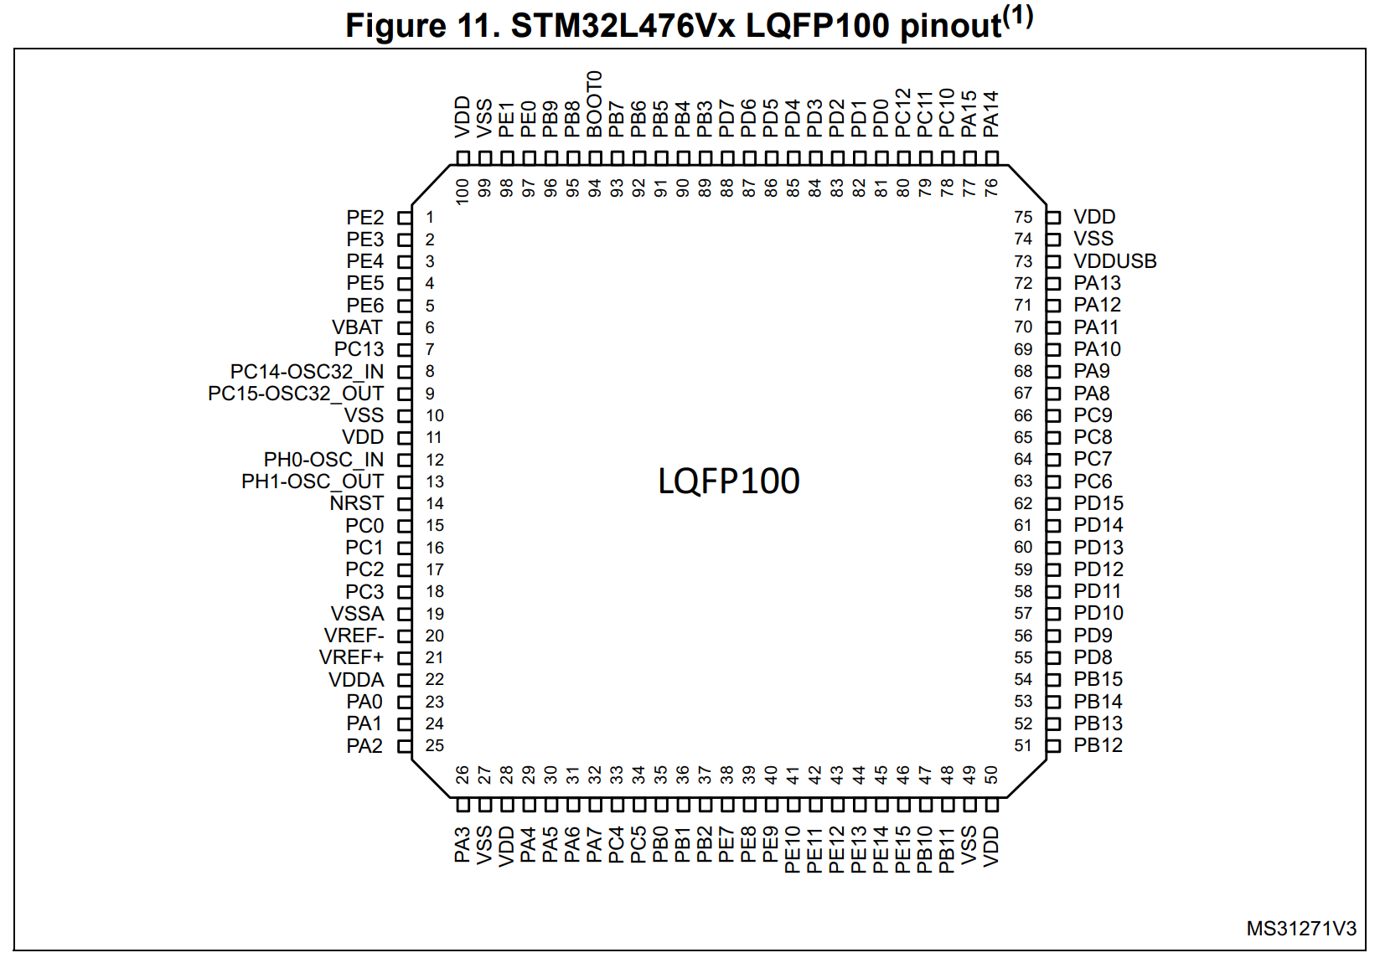
CAN_RX
CAN_TX
PD0: HSD1
RCC_MCO
DAC1
DAC2

Slide 9
DAC voltage reference
-Vref needs to be tied to AVss
AVdd
AVdd
+Vref
+Vref
2.048 or 2.5V bandgap reference
DAC
DAC
To ADC Vref
-Vref
-Vref
AVss
AVss
+Vref pin is an input!
+Vref pin is an output!

Slide 10
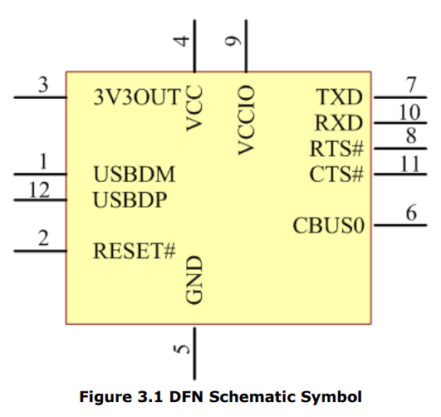
UART interface
FT234XD-R
Fuse removed
5V
USB

Slide 11
To do:
Link +Vref to Avdd
Link –Vref to Avss
Remove USB fuse
Is USB 5V linked to general 5v supply on board?
To do:
Link +Vref to Avdd
Link –Vref to Avss
Remove USB fuse
Is USB 5V linked to general 5v supply on board?
Are keyswitch inputs 5V tolerant?
Power for I2C bus expander (MCP23017)? – 5V but not shown on circuit diagram along with C26
I2C pullup resistors? On both busses?
I2C device memory & port expander are on separate buses!
CAN connector on flying lead
Analogue outputs saturate with only a fraction of DAC output swing
Fuse removed from USB power supply – plug a USB cable in and we get an ‘unrecognised device’ error
FTDI device configuration?
Dummy loads for HS & LS drive
RS485 comms interface & cabling

Slide 12
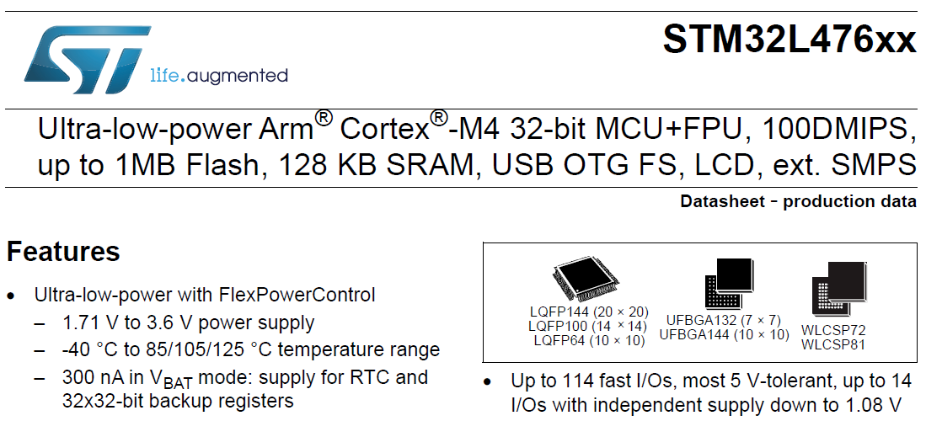
Which GPIO are 5V tolerant?

Slide 13
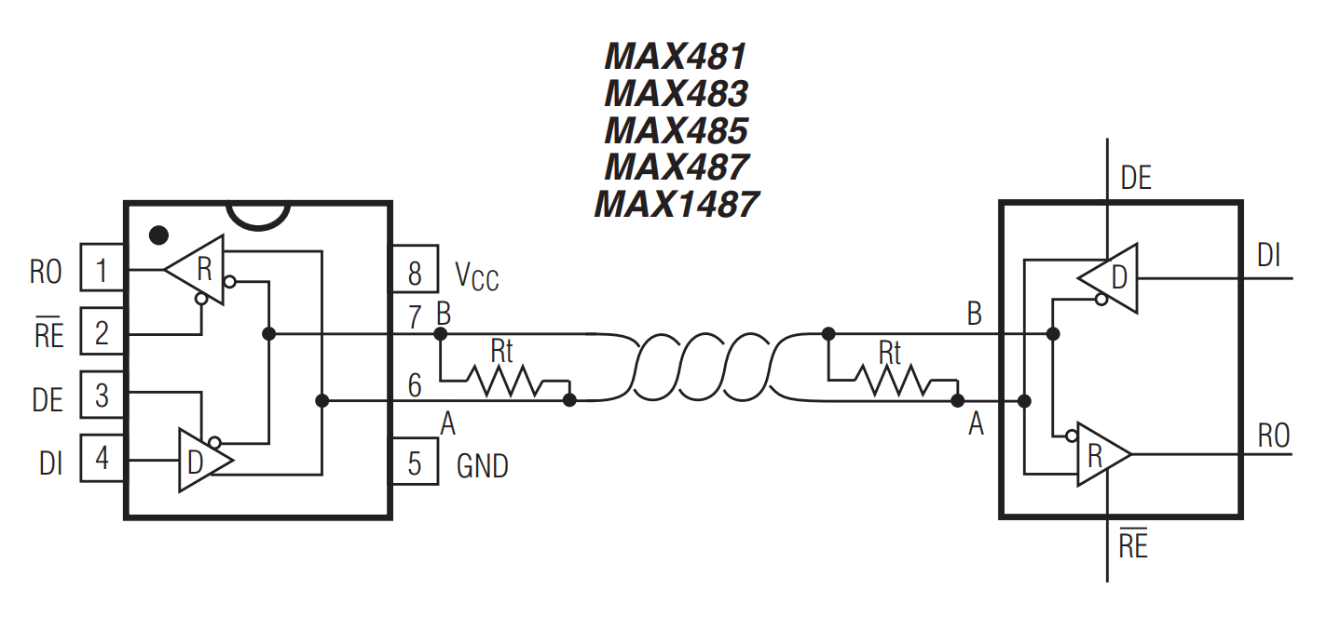
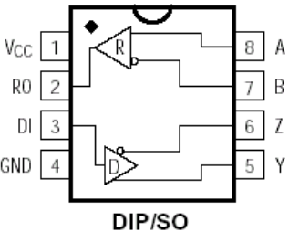
USART3
MAX485 comms
PC4
PC5
Is silk screen incorrect?
Tx
B
A
Z
Rx
Y
Sequencer connection

Slide 14
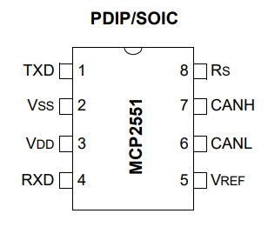
CAN interface
1Mbit/sec
CAN1_Tx PB9
CAN1_Rx PB8

Slide 15
CAN interrupts:
To enable interrupts:
HAL_CAN_Activation(CAN_HandleTypeDef * hcan, uint32_t ActiveITs)
CAN_IT_RX_FIFO0_MSG_PENDING | CAN_IT_ERROR
Why would you use the macro???
__HAL_CAN_ENABLE_IT(Handle, INTERRUPT)
__HAL_CAN_ENABLE_IT(&hcan1, CAN_IT_RX_FIFO0_FULL | CAN_IT_ERROR);

Slide 16
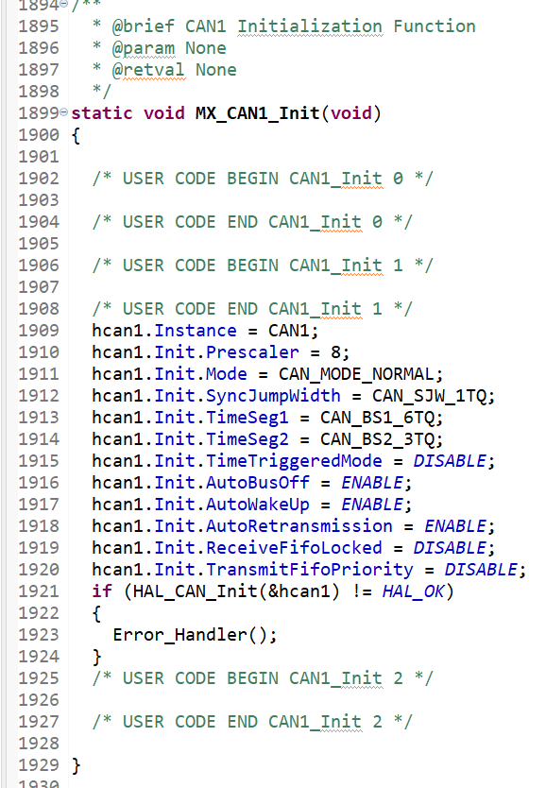
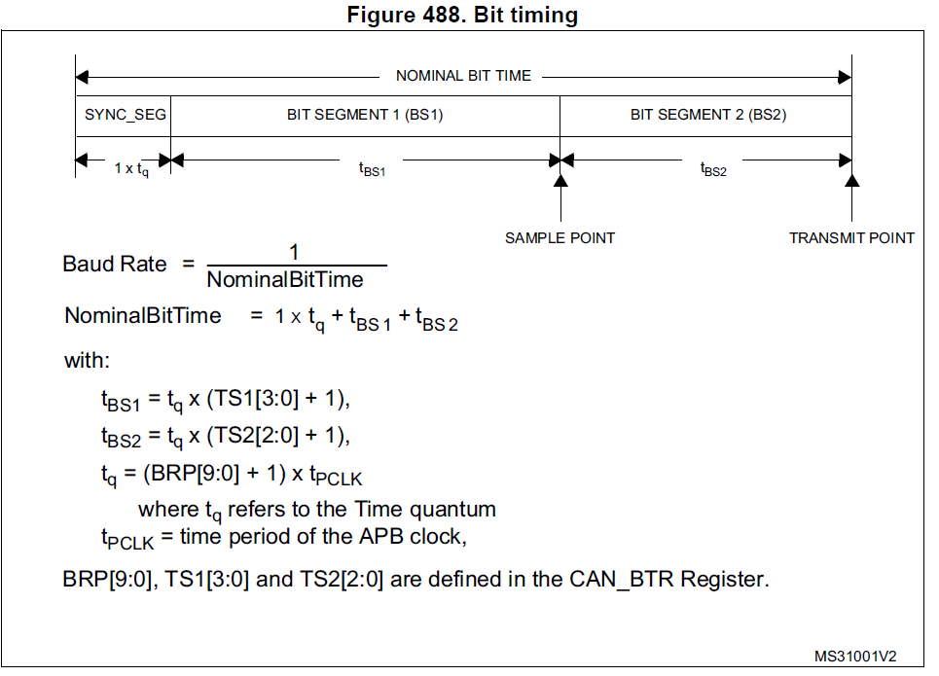
CAN setup

Slide 17
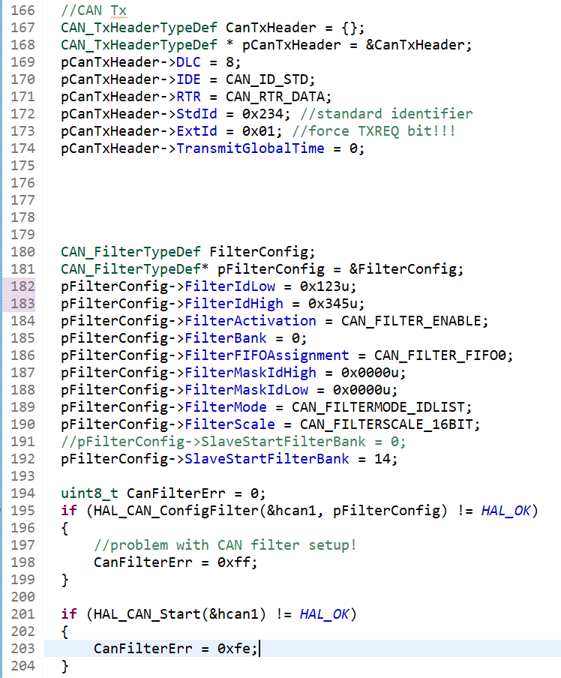
CAN setup
Why have I still got this???

Slide 18
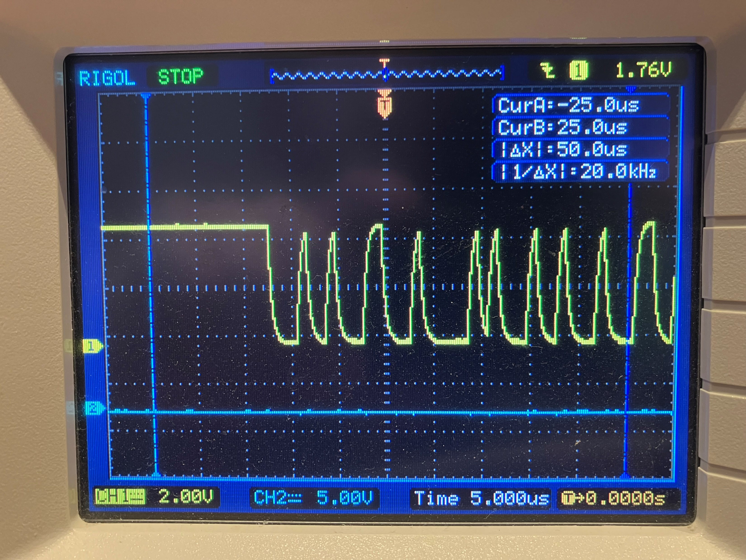
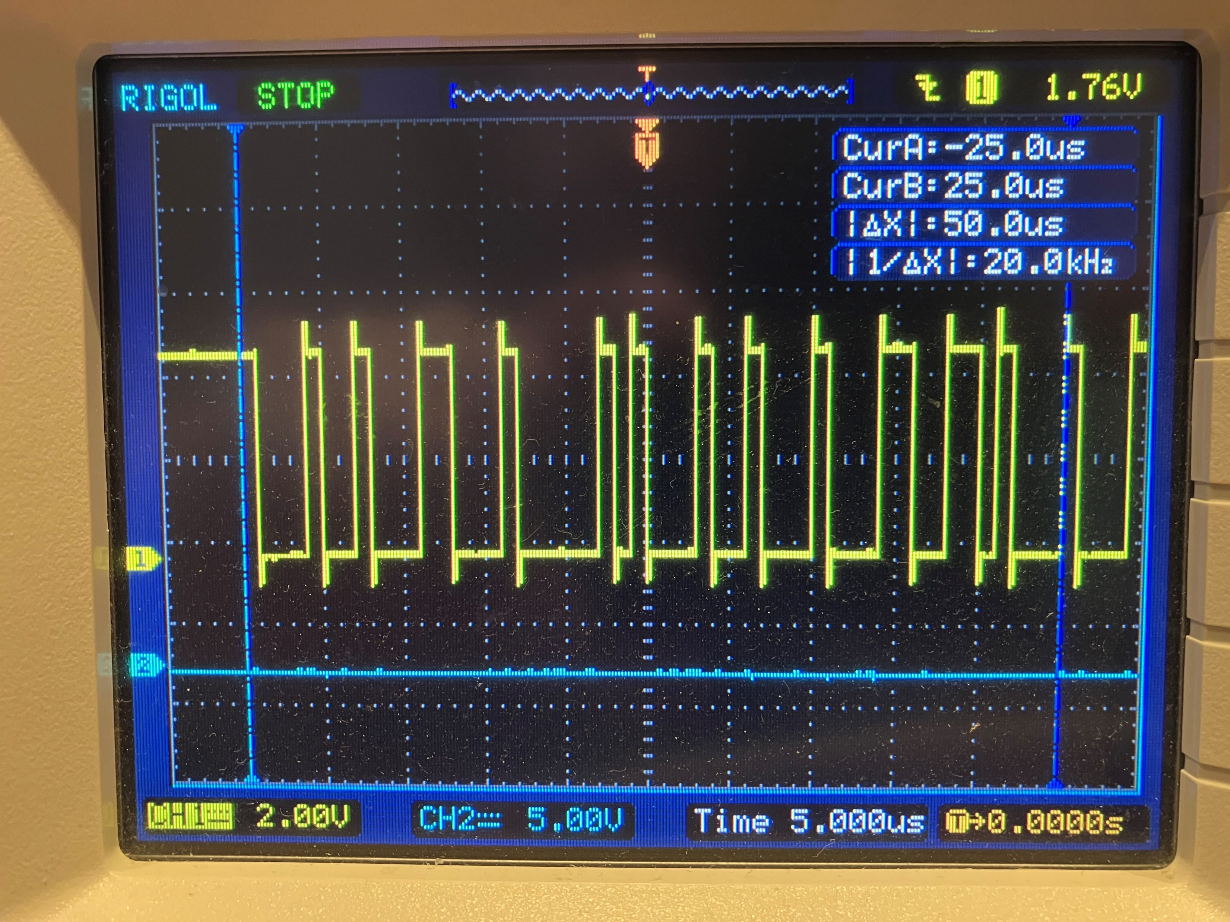
MCP2551 (U5) p4:
CANRx Input to uC PB8: 10k series resistor too strong!!!
TTL CAN data output from PCAN & MCP2551
10k seems to be OK on the RS485 driver

Slide 19
CAN issue on P1399 EOL test setup:
CAN transceiver wasn’t being enabled
Sequencer 2:
High value series resistors seem to be distorting original CAN pulses
PCAN seemed to stop working with the hardware!!!! Unplug and restart app got it working again!

Slide 20
CAN TX issue on Sequencer MkII board 17APR2024
CAN Tx mailbox is successfully filled,
HAL_CAN_AddTxMessage() successfully called but no bitstream from the controller
Sending a message from PCAN seems to result in ‘bus heavy’ and single transmission turns into repeated PCAN transmission
The controllers CAN Tx line seems to produce error frames? (~41usec low pulses)
41/12 = 13.6usec/bit = 292kbit
TERR = 1
Transmit priority?
CAN_TSR register reports: 0x1900 0008
CAN_ESR register reports 0x0700 0055
Controller was set to loop back mode & not physically connected to a CAN bus
BOFF = 1
GF = 1
LEC[2:0] = 101 = Last error code = Bit dominant error
REC[7:0] = 0x07 = receive error counter

Slide 21
18APR2024
CAN TX & RX series resistors bypassed – no improvement
PCAN CAN signal is reaching controller PB8
No hint of signal from PB9??? (CAN_Tx = PB9 = currently high (3.3V))
When processor is reset, the CAN_TX line jumps up to 5V
Remove R1 – break link with MCP2551. During processor reset this line now drops to 0V
Is the clock speed an issue?
CAN_BTR = 0x4010 0009
BRP[7:0] = 0x09
SJW[1:0] = 0x01
LBKM: Loopback mode enabled

Slide 22
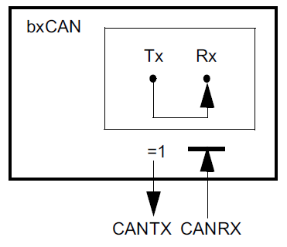
18APR2024 (2)
Try loopback in silent mode
Same error occurs – is there a problem with the chip?
Are PB8 & 9 5V tolerant? YES
Check clock configuration!!!!

Slide 23
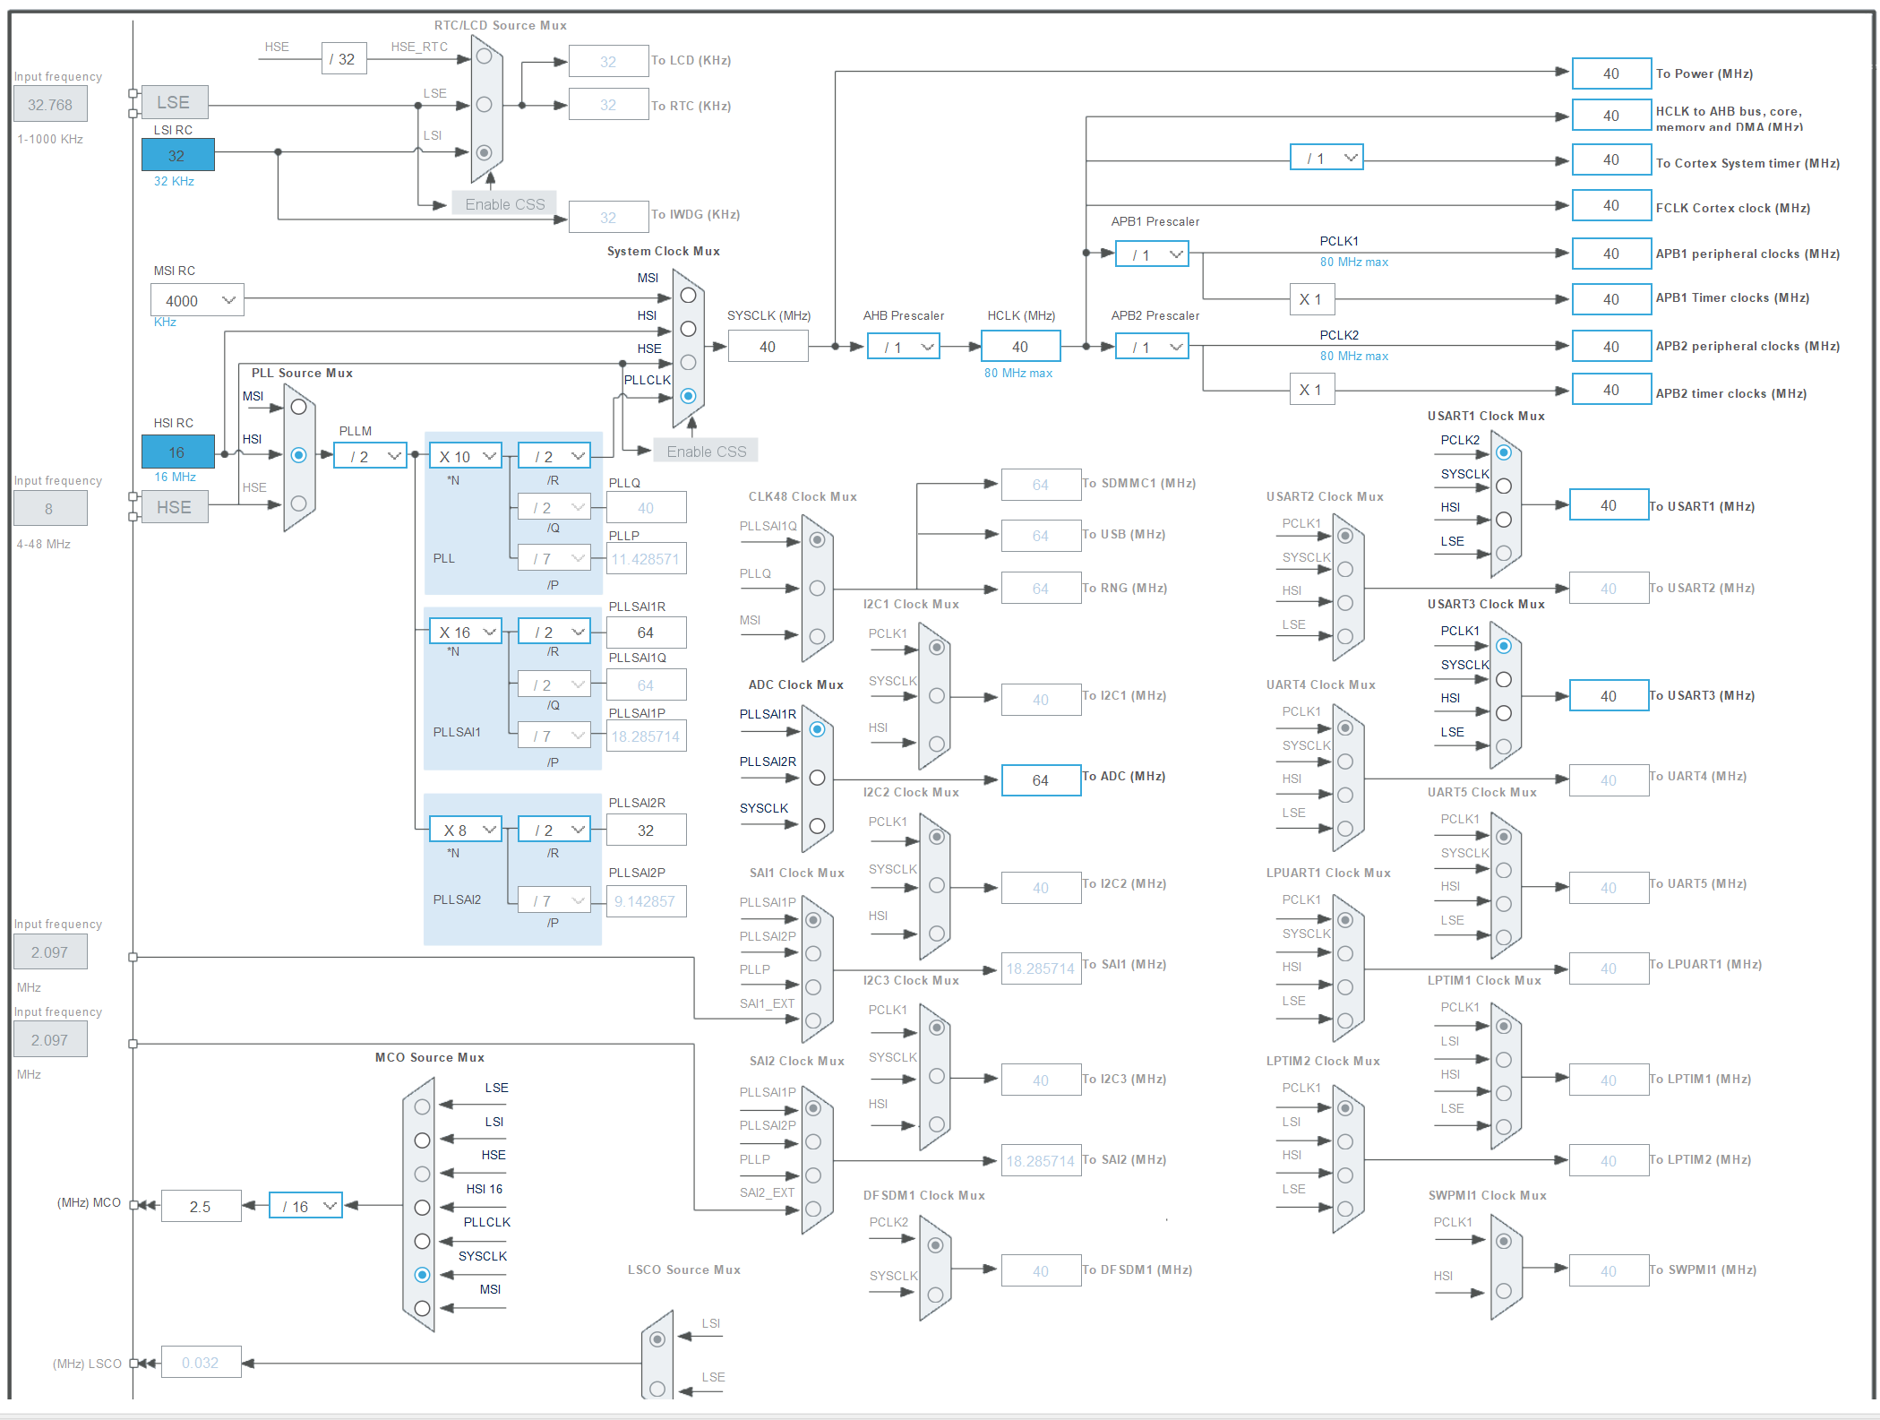
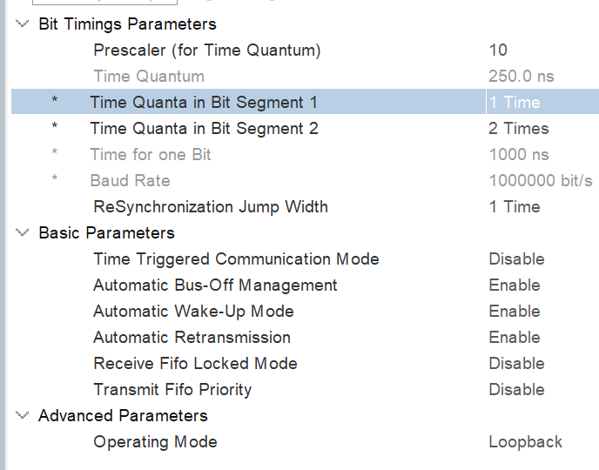
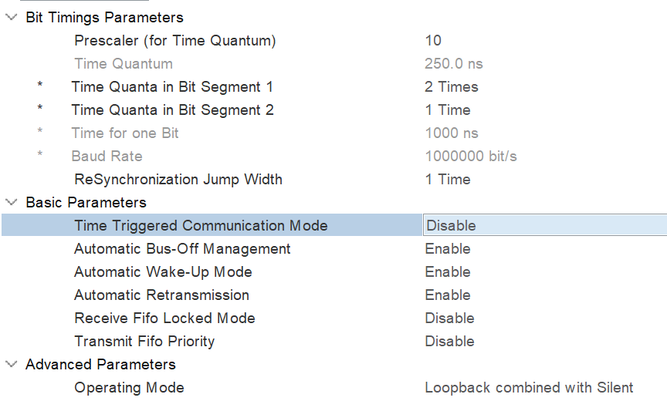
Pre 18APR2024 clock config
❶
This doesn’t work!
❸
This does work!

Slide 24

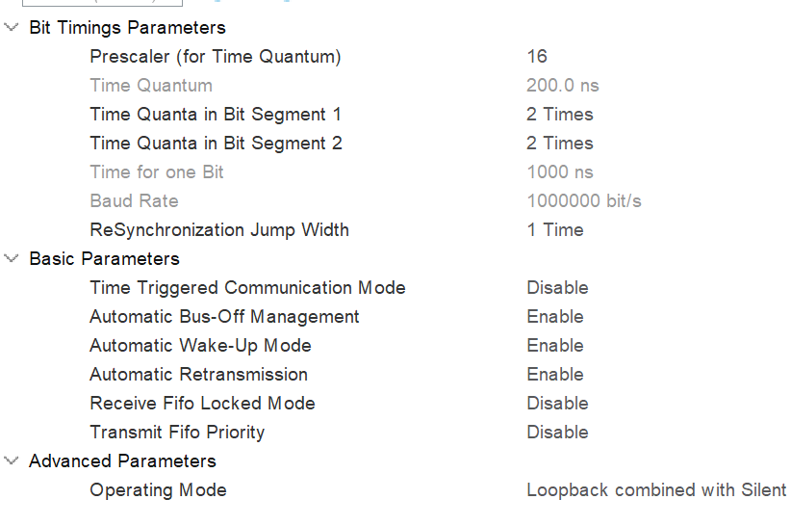
This got the CAN working
❷
This does work!
Changed this and CAN loopback immediately started working!

Slide 25
CAN message reception
HAL_CAN_ActivateNotification(&hcan1, CAN_IT_RX_FIFO0_MSG_PENDING)
CAN message reception
void HAL_CAN_RxFifo0MsgPendingCallback()
HAL_CAN_GetRxMessage()

Slide 26
MISRA rules: place a ‘u’ after an unsigned int value

Slide 27
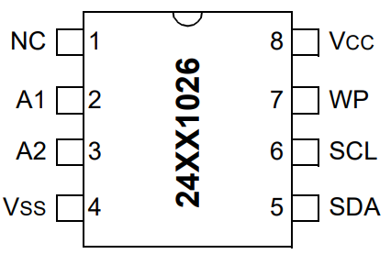
I2C comms with external memory device
19APR2024
Wrong 16bit internal address seems to be sent
uC
PB14
SDA
PB13
SCL
I2C port 2
Uses Tx & Rx interrupts to prevent ‘blocking’

Slide 28
Passing structures from functions
GcI2cV1.c
GcI2cV1.h
Function returns a pointer to the structure
struct I2cConfig{
uint16_t I2cInternalAddress;
uint16_t I2cQuantity;
uint8_t I2cInternalAddressWidth;
uint8_t I2cDeviceAddress;
}structI2cConfig;
This needs to be inm the h file to allow an instance to be made in main.c!!!
struct I2cConfig* GetI2cConfig(void)
{
return &structI2cConfig;
}
main.c
#include "GcI2cV1.h“
struct I2cConfig* structptr;
structptr = GetI2cConfig();
Uint8_t x = structptr->I2cDevbiceAddress
Create a suitable pointer to the structure type
Pointer points to the data structure

